Slide 1

RFID Systems
and Their Use Tracking
Calibrated Tools
Sponsor: Mike Eckery
Presented By: Sheana Reigle
University of Nebraska-Lincoln

Slide 2

Today’s Agenda
Introduction of Presenter and Project
Six Sigma Methodology
Define Phase
Measure Phase
Analyze Phase
Introduction to RFID
Future of Project
Recap of Presentation

Slide 3

General Dynamics
Technical and Armament Products Company
Located in Lincoln, Nebraska
Specialize in the production of composite structures for aerospace, defense, and commercial markets

Slide 4

Methodology

Slide 5
Six Sigma Process Methodology
    Define Project Area
    DEFINE
    Prepare for Project Execution
    Step 1
    Select Critical Characteristics
    MEASURE
    Step 2
    Determine Targets and Specifications
    Step 3
    Validate Measurement System
    Step 4
    Establish Baseline
    ANALYZE
    Step 5
    Determine Improvement Objectives
    Step 6
    Study Process Inputs
    Step 7
    Determine Potential Causes
    IMPROVE
    Step 8
    Quantify Key Input Settings
    Step 9
    Formulate Implementation Plan
    Step 10
    Validate the Plan
    CONTROL
    Step 11
    Control Inputs and Monitor Outputs
    Step 12
    Sustain the Change

Slide 6
Define

Slide 7

Define Project Area
Project Risk Analysis
  Project evaluated in three dimensions
Project Return Analysis
Creation of Project Charter
  Problem Statement
  Mission Statement
  Baseline

Slide 8
Project Return
Growth = Competitive Advantage
  The project does not create incremental sales with paying customer(s), but does improve the competitive position of the company by improving operation efficiencies that bear on competitive performance = 1 point
Urgency = Competitive Response
  The postponement of the project does not affect competitive position; however, operating costs may escalate to produce substantially the same result = 2
Impact = Annual Expected Financial Savings
  $100,000-$200,000 = 2
Growth Score: 1/5
Urgency Score: 2/5
Impact Score: 2/5
Return Value: 5/15 = .33 = 33%

Slide 9

Project Risk
Project Risk Categories
Define Opportunity
  Total Score = 175
Customer Focus
  Total Score = 125
Company Benefit/Leveraging
  Total Score = 30
Project Leadership/Global Bounding
  Total Weighted Score = 135
Project Risk = 465/(200*5) = .465 = 46.5%

Slide 10
Project Charter
Black Belt Sheana Reigle
Sponsor Mike Eckery
Finance Representative N/A
Problem Statement Time spent searching for calibrated tools has become significant, thus
losing that same time to productivity
Project Y and Baseline Search time every week with the baseline coming
from a current time study
Performance Critical characteristics to the project include:
Tool location
Number of tools
Goal Statement Reduce the amount of search time for calibrated tools by 90% week thus
increasing productivity by the same amount

Slide 11
Measure

Slide 12
Select Critical Characteristics
Potential X’s (Inputs)
Hidden Tools
Stolen Tools
Lost Tools
Non-Calibrated Tools
Poor Use
Potential Y’s (Outputs)
Audit Results
Defects
Lost Production Time
Lost Labor Time
Lost Sales
Project
Inputs
Outputs

Slide 13
XY Matrix (QFD)
 | Output Variables | Audit Results | Defects | Lost Production Time | Lost Labor Time | Lost Sales | Product | Rank
 | Rank | 7 | 8 | 10 | 9 | 8
Inputs
Hidden Tools |  |  | 3 |  | 6 |  | 78 | 5
Stolen Tools |  |  |  | 6 | 6 |  | 72 | 4
Lost Tools |  | 4 | 5 | 8 | 9 |  | 229 | 10
Non-calibrated Tools |  | 6 | 7 |  |  |  | 98 | 8
Poor Use |  |  | 5 |  |  | 7 | 96 | 6

Slide 14
Measure Statements
Not able to use regression due to lack of quantitative data (y=mx+b)
Found lost tools to be the major cause according to XY matrix
Focus moving into analyze around solving the problem of lost tools

Slide 15
Analyze

Slide 16
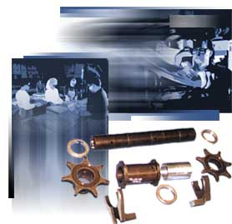
Baseline
Baseline Costs to General Dynamics:
  Audit costs
    Redesign of processes
    Lean manufacturing initiative
  Defects
    Rework due to defects
    Production time lost
    Scrap
  Labor Costs
    Search time for tools
  Lost Sales
  Lost/Stolen Tools

Slide 17
Improvement Objectives
Mission Statement Reinforced:
  Reduce the amount of search time for calibrated tools by 90% thus increasing productivity by the same amount
  Minimize tools lost within the production facility
  Save General Dynamics $100,000 in costs over a 5 year period

Slide 18
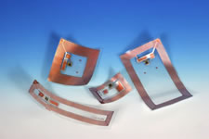
Introduction of RFID
What is RFID?
How can RFID be used in this scenario?
Would RFID provide the most benefit?

Slide 19
RFID: A little background…
Radio Frequency Identification
A “super barcode” which does not need direct line of sight in order to scan
Requires four components:
  Reader
  Transponders (more commonly called tags)
  Antenna
  Application Software

Slide 20
What's Next?

Slide 21
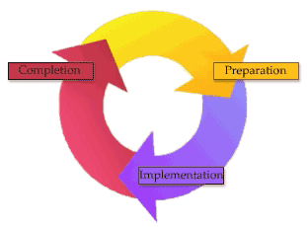
Future Steps
Analyze
  Determine Potential Causes
    Formulate Design of Experiments to identify practicality of using RFID
Improve
  Determine plan for implementation
  Revise cost analysis
Control
  Set up Control Plan
    Proposal to Upper Management
  Validate the Plan
    Implementation of RFID
  Control Inputs, Monitor Outputs
  Sustain the Change

Slide 22
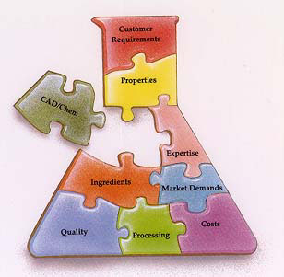
Commitments
In process of designing experiments
Testing:
  Type of tag to use
  Material
  Distance
  Life
Refigure cost analysis after experimentation
Proposal to General Dynamics of findings

Slide 23
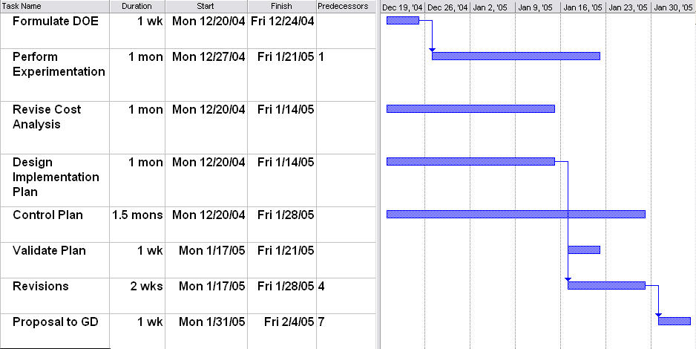
Schedule

Slide 24
Conclusion
Findings:
  Lost tools concern in facility causing search time and defective products
  Potential of RFID use being investigated
Future of Project:
  Completion estimated to be mid-February
  Proposal to General Dynamics at completion of project
Cost analysis showing large opportunity for savings at approximately $1.5 million over a 5 year period

Slide 25
Questions??

